Slide 1
Hub
Actions
Store
dispatcher$

Slide 2
Action: FETCH_TODOS_SUCCESS
fetchTodosEffect$
replay of action sent to effect
Store
dispatcher$
Action: FETCH_TODOS

Slide 3
fetchTodosEffect$
Store
id: 2
id: 1
dispatcher$
Action: UPDATE_TODO
{ id: 1 }
id: 1
updateTodoEffect${ id: 1}
id: 1
id: 2
Action: UPDATE_TODOS_SUCCESS
{ id: 1 }
Action: UPDATE_TODO
{ id: 2 }
updateTodoEffect$
{ id: 2 }
id: 2
Action: UPDATE_TODOS_SUCCESS
{ id: 2 }
Scoped Effects

Slide 4
Hub
Store
Hub
Store
Store
Store
Store
Hub
Store
Store
Store
Hub
Store
Hub
Store
Hub
Store
Hub
Store

Slide 5
App
Hub
Store
Component
Hub
Store
Store
Component
Store
Store
Hub
Component
Component
Component
Store
Store
Store
Hub
Store
Component
Component
Component
Hub
Store
Hub
Store
Hub
Store

Slide 6
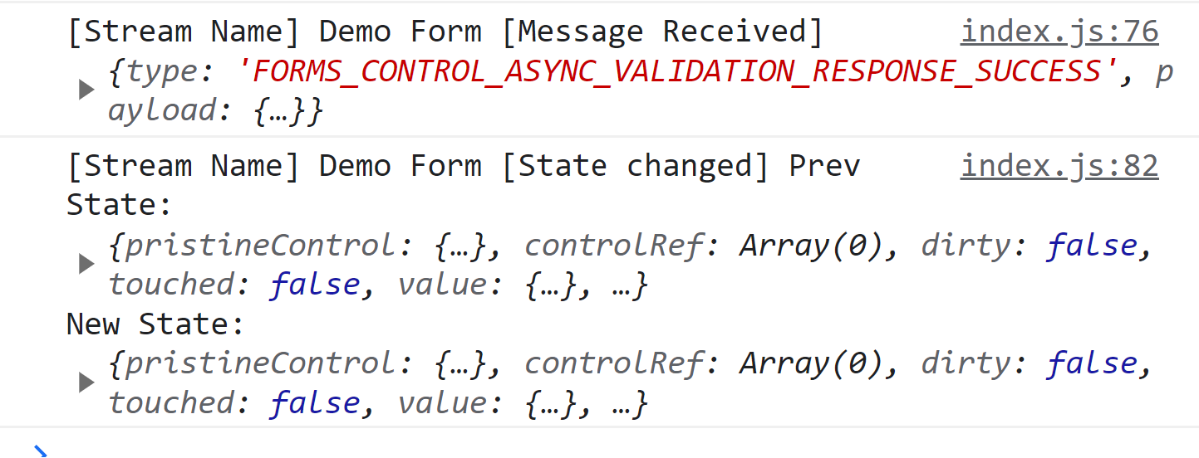

Slide 7
id: 2
id: 1
Store
id: 1
id: 1
id: 2
id: 2

Slide 8
App
Hub
Store
Component
Hub
Store
Store
Component
Store
Store
Hub
Component
Component
Component
Store
Store
Store
Hub
Store
Component
Component
Component
Hub
Store
Hub
Store
Hub
Store

Slide 9
??? What to use ???
Frontend Framework | Application (global) State | Component (local) state
React | Redux Context API | useState useReducer
Angular | NgRx Angular Services | Signals RxJS Observables Component class properties
Vue | Pinia Reactivity API Vuex | ref
Frontend Framework | Application (global) State | Component (local) state
React | Reactables
Angular
Vue

Slide 10
Reactable Forms
View
Hub 1 – User Actions
User Input
Hub 2 – Async Validation
Base Form Store
(partial validation)
controlAsyncValidator$
Validated Form Store
dispatcher$
sourceForHub2$
controlAsyncValidator$
Dispatcher (User) Actions
FORMS_CONTROL_CHANGE
FORMS_ADD_CONTROL
Source For Hub 2 Actions
FORMS_FORM_CHANGE
FORMS_ASYNC_VALIDATE_CONTROL
FORMS_ASYNC_VALIDATE_SUCCESS_RESPONSE

Slide 11
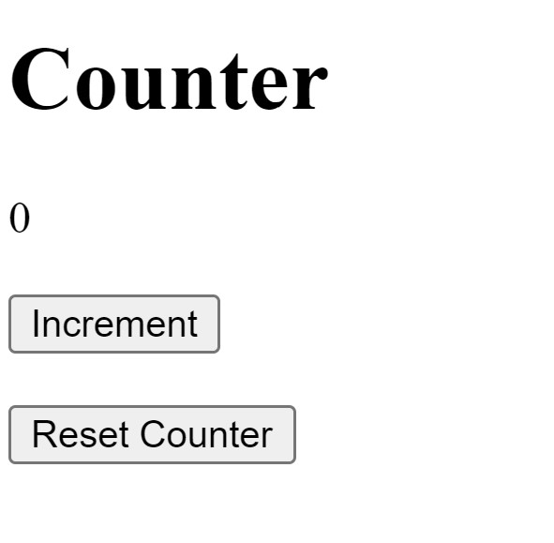
RxCounter
State:
{ count: 0 }
Actions
Increment
Should increment counter by 1
Reset
Should reset counter to 0
Update View
dispatcher$

Slide 12
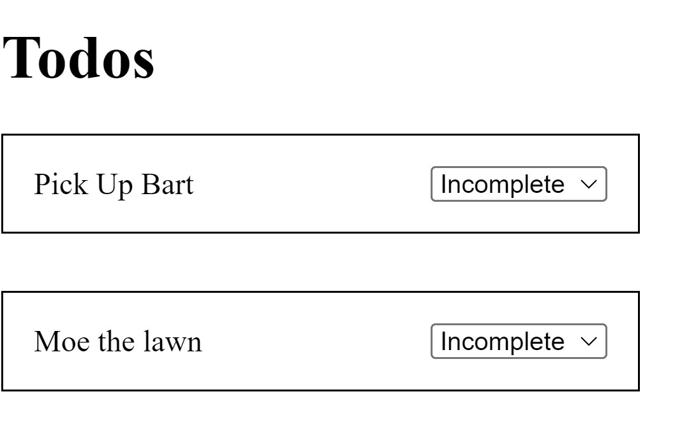
RxTodoUpdates
State:
{
todos: [
{
id: 1,
description: 'Pick Up Bart',
status: 'incomplete',
updating: false,
},
{
id: 2,
description: 'Moe the lawn',
status: 'incomplete',
updating: false,
},
],
}
id:1
Update Todo Api
id: 1
Actions
Send Todo Status Update
Change Todo `updating` to true
Todo Status Update Success
Update Todo `status` and change `updating` to false.
Update View
dispatcher$
id:2
id:1
id:2
id: 2
Update Todo Api
id:2
id:1
id:2
id:1

Slide 13
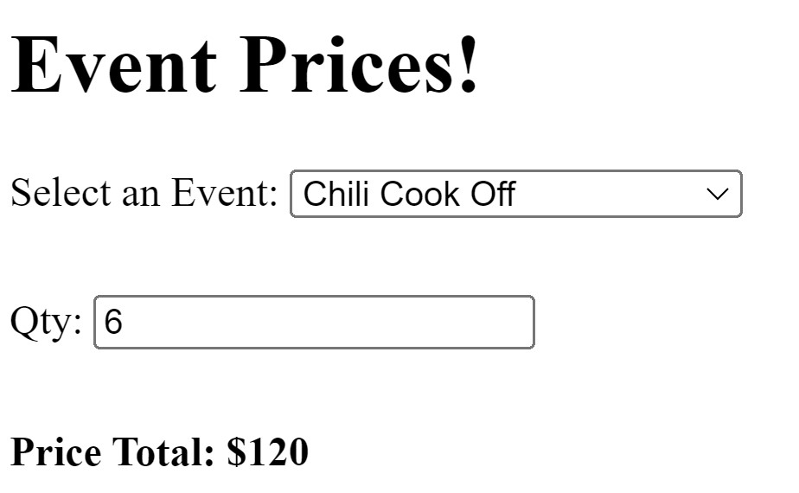
RxEventTickets
State:
{
selectedEvent: 'Chili Cook Off',
qty: 6,
}
Actions
Select Event
Set Quantity
Controls Change
Fetch Price Success
dispatcher$
State:
{
controls: {
selectedEvent: 'Chili Cook Off',
qty: 6,
},
calculating: false,
price: 120,
}
Get Price Api
Source
Update View

Slide 14
??? What to use ???
Frontend Framework | Application (global) State | Component (local) state
React | Redux Context API | useState useReducer
Angular | NgRx Angular Services | Signals RxJS Observables Component class properties
Vue | Pinia Reactivity API Vuex | ref
Frontend Framework | Application (global) State | Component (local) state
React | Reactables
Angular
Vue

